Slide 1
ART 2650
Introduction to Design Process and Programming
Fall 2017
M, W 11:50 AM to 1:10 PM
Grover Center W125
Professor: Matthew Ziff
Light & Sun

Slide 2
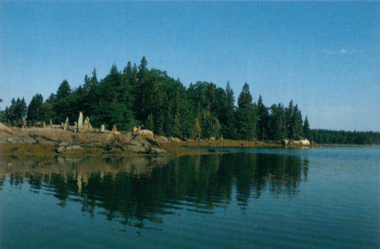
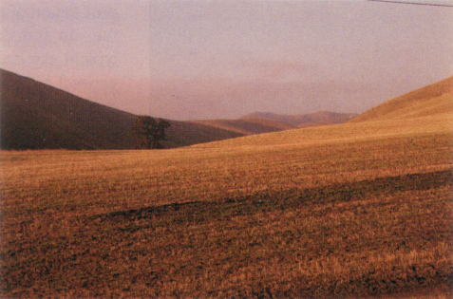
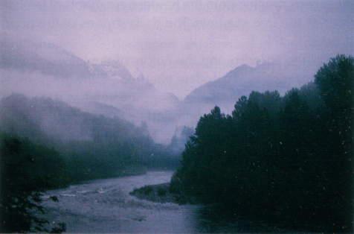
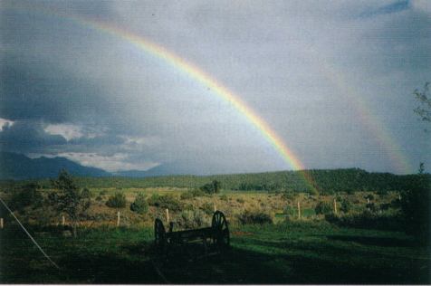
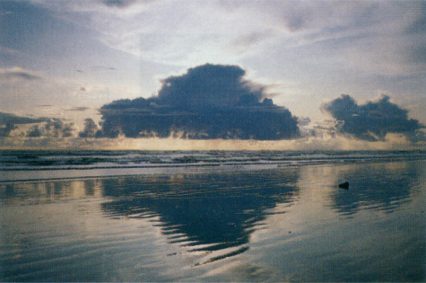
Understanding Light and Place: Where are we on the surface of the Earth?
Maine, 44 deg. North
Washington, 47 deg. North
Washington, 48 deg. North
Taos, NM 37 deg. North
Costal Washington, 48 deg. North

Slide 3
The Sun’s path through the year

Slide 4
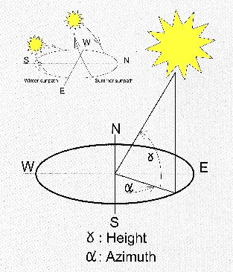
The sun’s location in the sky is described by its height, and its N-S place:
These are called the Altitude angle and the Azimuth angle.

Slide 5
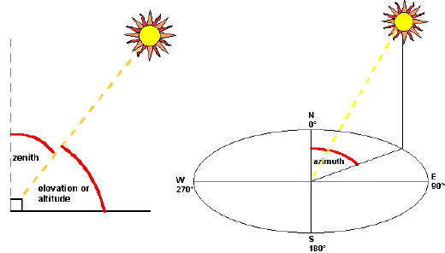
Altitude & Azimuth

Slide 6
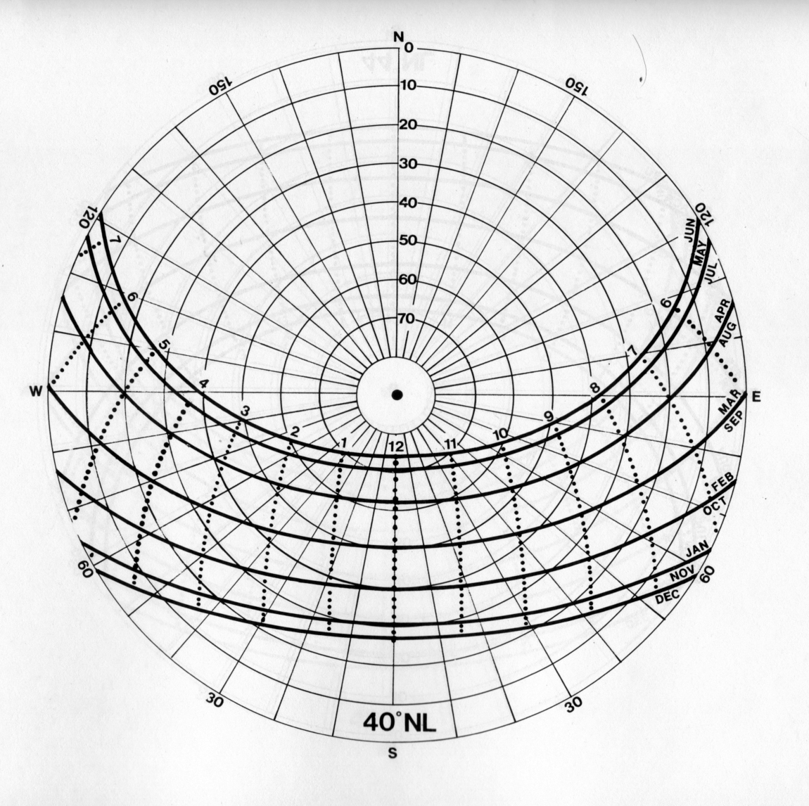
Understanding the Sun, Season and Time of Day
40 Degrees North Latitude, 82 degrees w west longitude; Columbus, OH

Slide 7
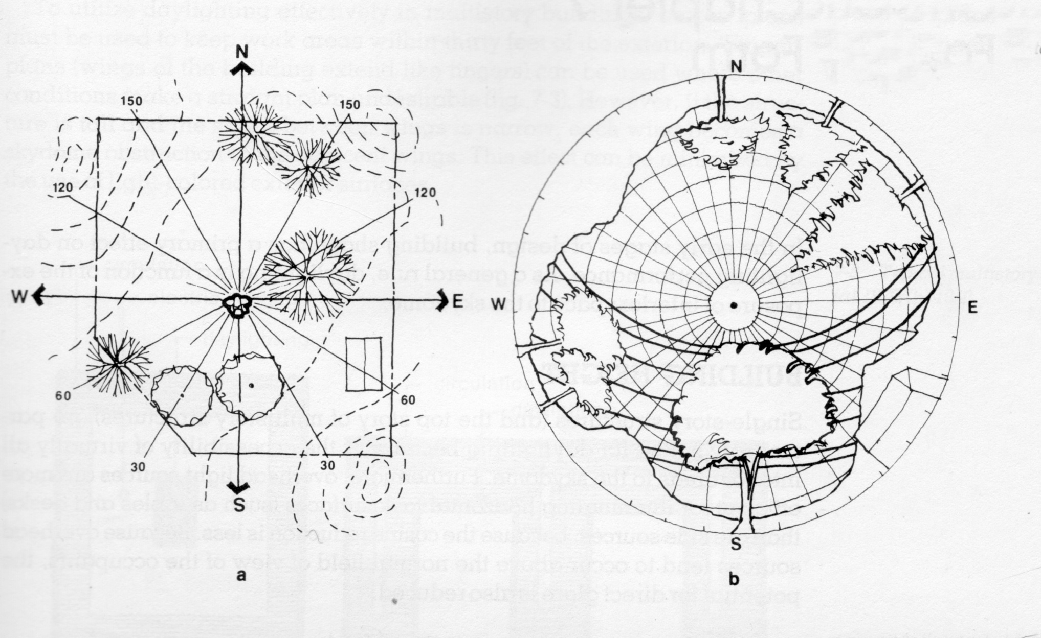
Site Analysis of Light and Physical Conditions
40 Degrees Latitude

Slide 8
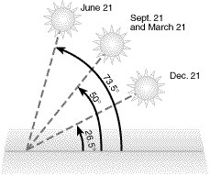
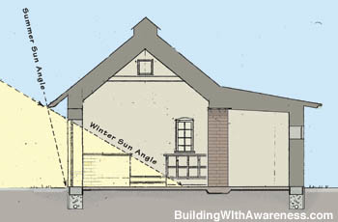
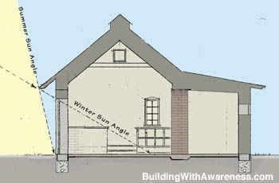
The position of the sun in the sky changes throughout the year.
The height of the sun, in the sky, at noon, across the year:

Slide 9
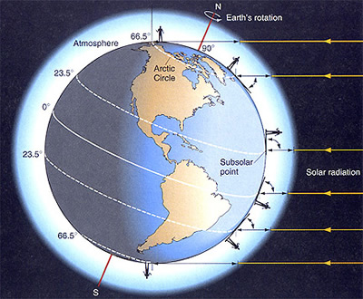
What causes winter and summer?

Slide 10
Athens, Ohio is located at:
82 degrees w West longitude
39.5 degrees North latitude

Slide 11
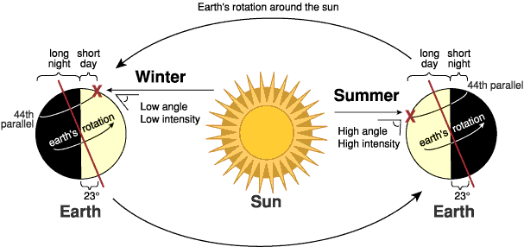

Slide 12
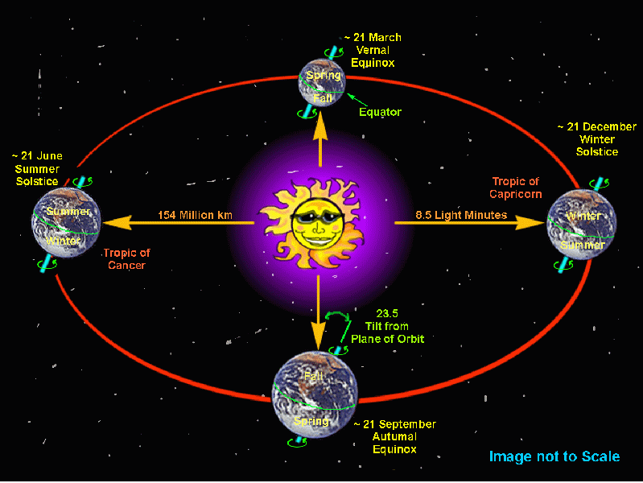
Relationship of the earth to the sun at different times of the year

Slide 13
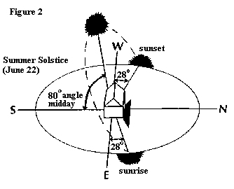

Slide 14
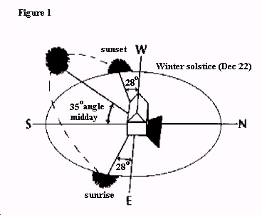

Slide 15
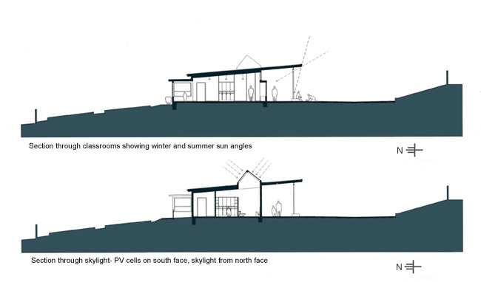

Slide 16
Ways to Capture Light in Spaces
Locate the space/building on the site so it receives light throughout the day.
Shape the space so light can enter every important room for at least two sides.
When light for a second side is not possible allow light from above.
Plan the placement of rooms so light is received at suitable times of the day.
Shape the size and shape of the opening (windows) to suite the activities and the climate.

Slide 17
Ways to Capture Light
Plan the details of design to create windows to the character of the space/building as a whole.
Use shading devises to control the amount of light and heat that enters the space/building.

Slide 18
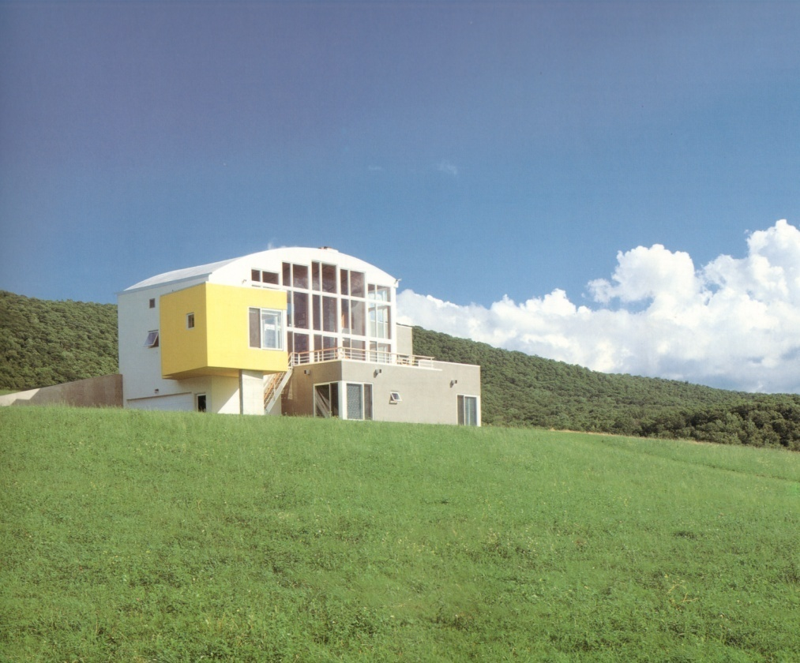
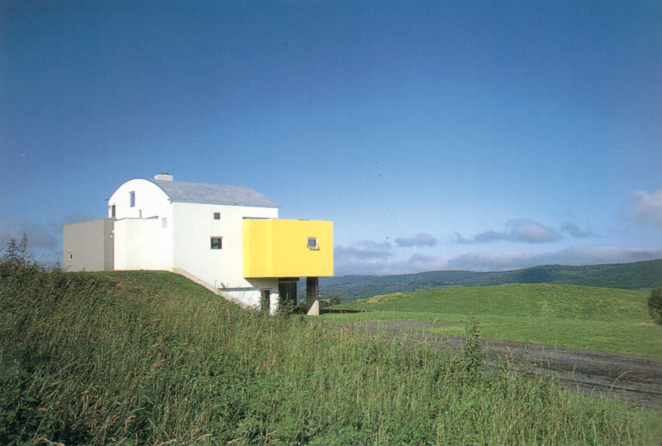
Locate the building on the site so it receives light throughout the day.
South facing façade of the home receives light thought most of the day.
Copake, New York
North facing windows provide privacy and allow light to enter the home in areas that require less light.
The northern exposure is protected.

Slide 19
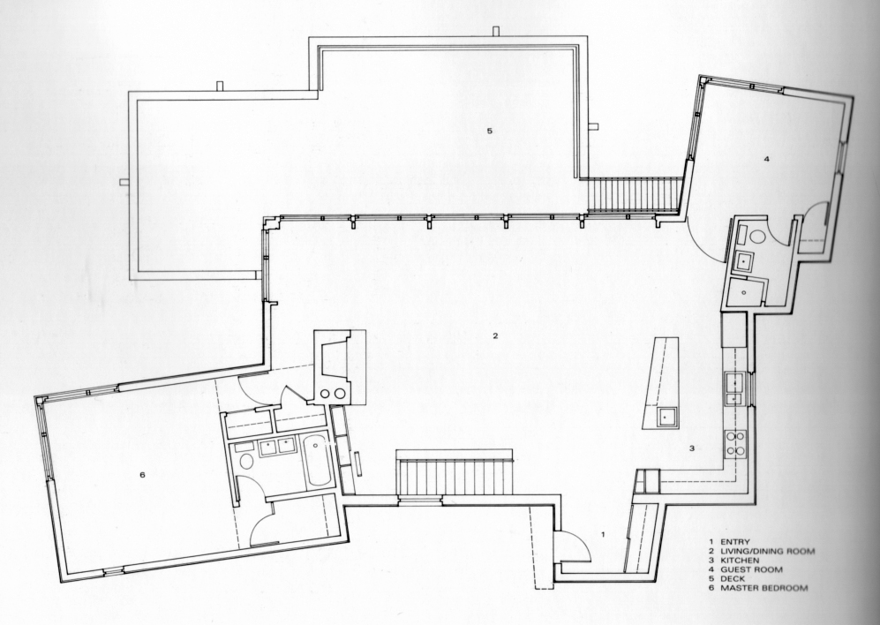
Locate the building on the site so it receives light throughout the day.
Light is also entering most rooms from at least two directions.

Slide 20
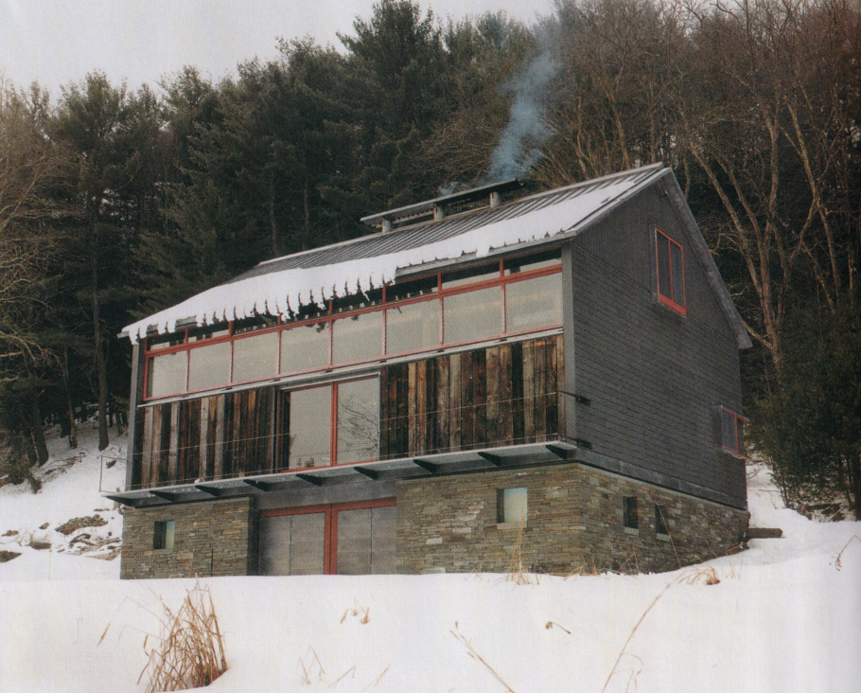
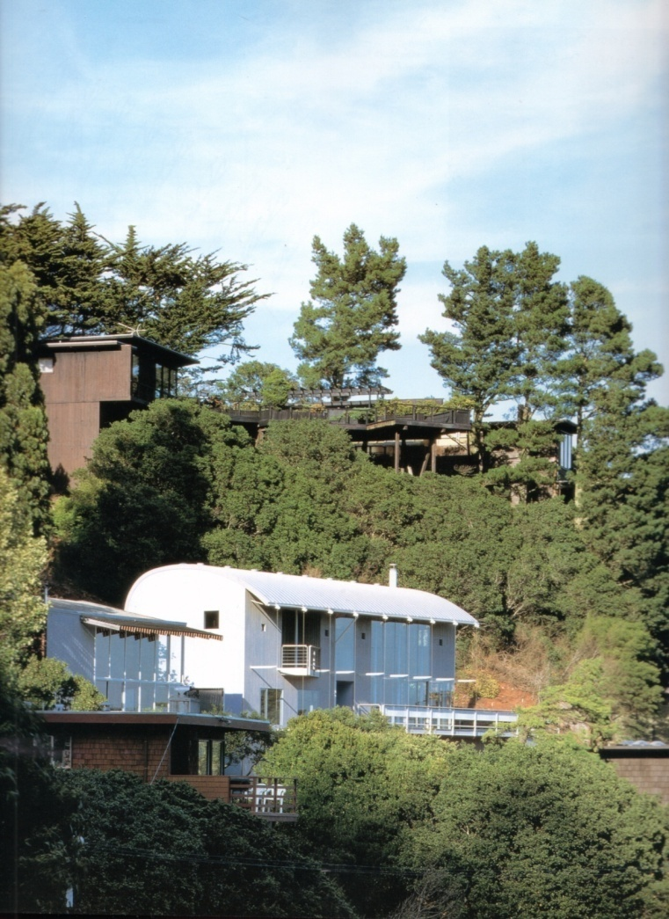
Locate the building on the site so it receives light throughout the day.

Slide 21
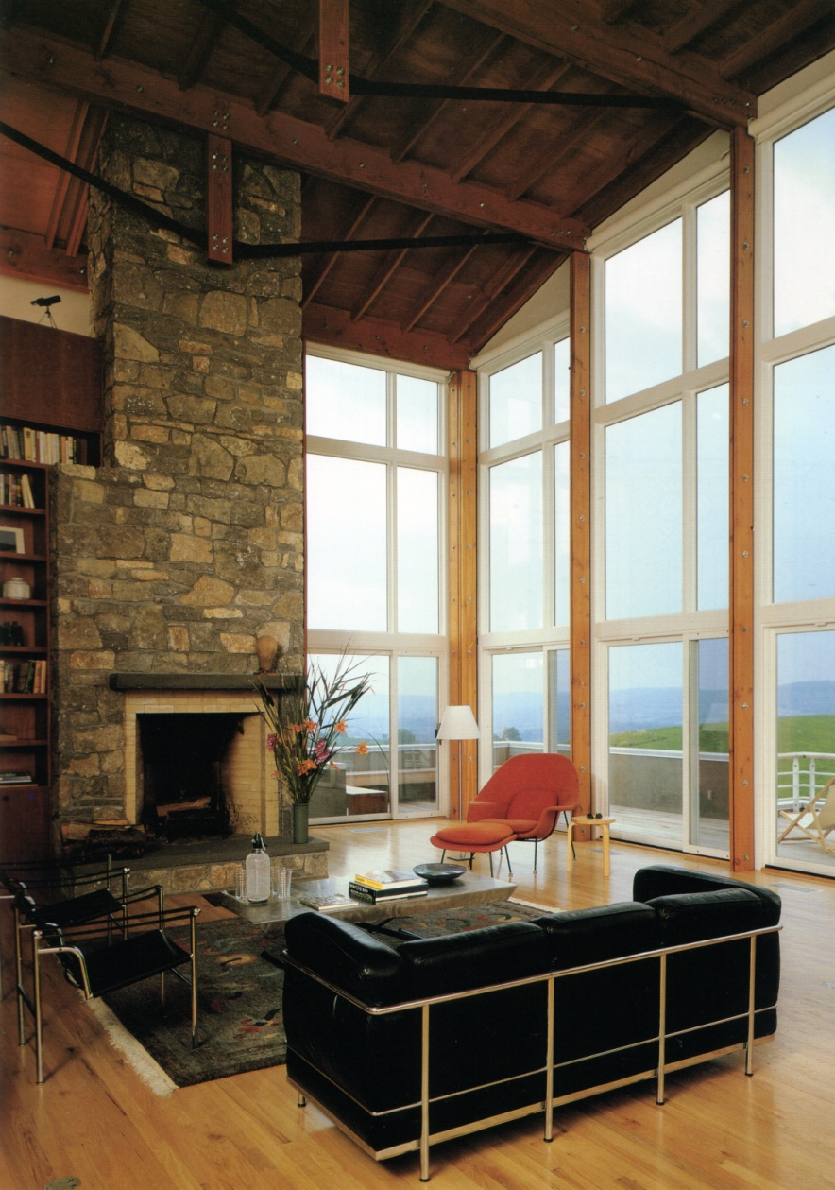
Locate the building on the site so it receives light throughout the day.

Slide 22
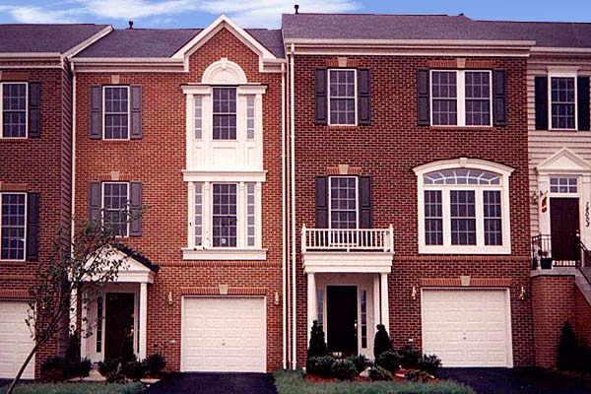
When possible shape the buiilding so light can enter every important room for at least two sides.
Townhouse in Rockville, MD
Light enters rooms from only one direction.

Slide 23
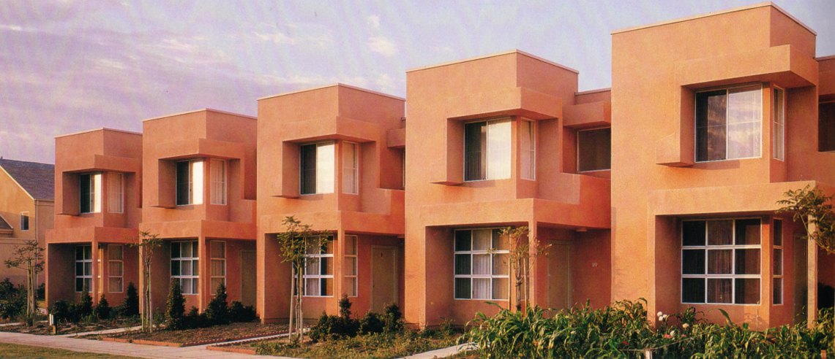
Shape the building so light can enter every important room for at least two sides.
Saticoy, CA
The intentional shaping of these buildings allows light to enter rooms from two directions.

Slide 24
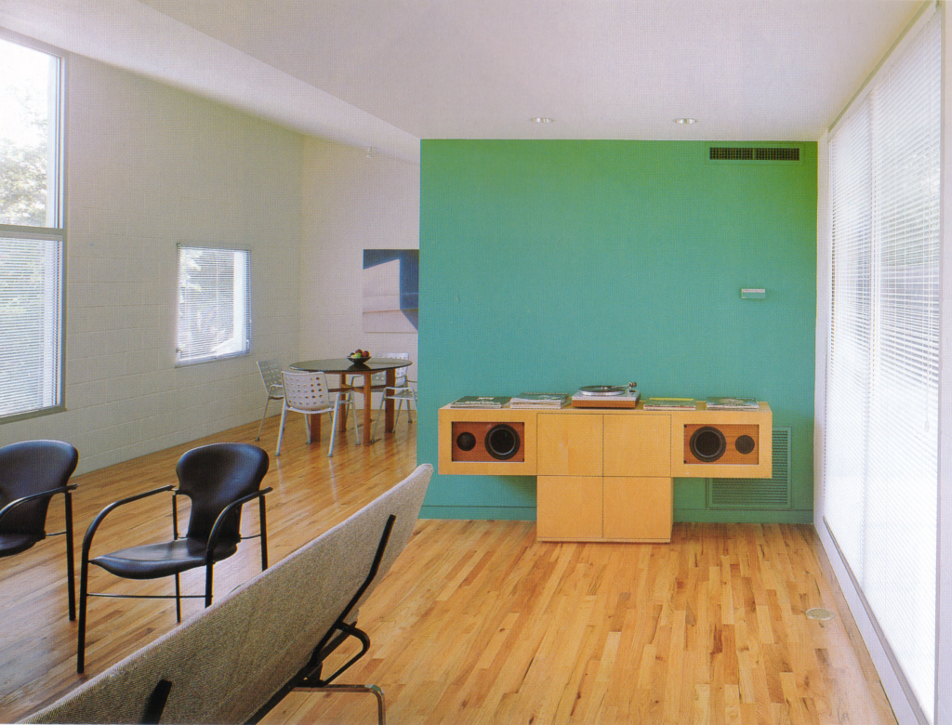
Shape the building so light can enter every important room for at least two sides.

Slide 25
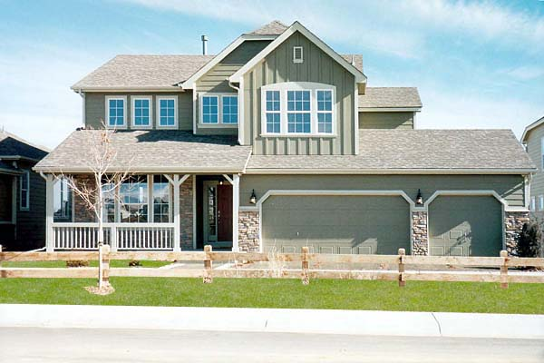
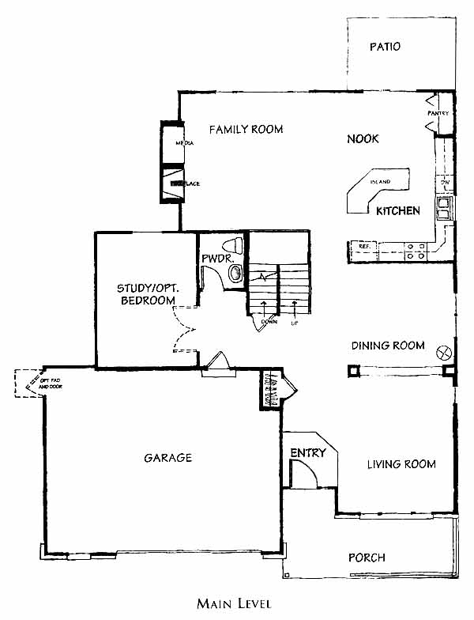
Shape the building so light can enter every important room for at least two sides.
Denver, CO
Light enters rooms from only one direction in most spaces.

Slide 26
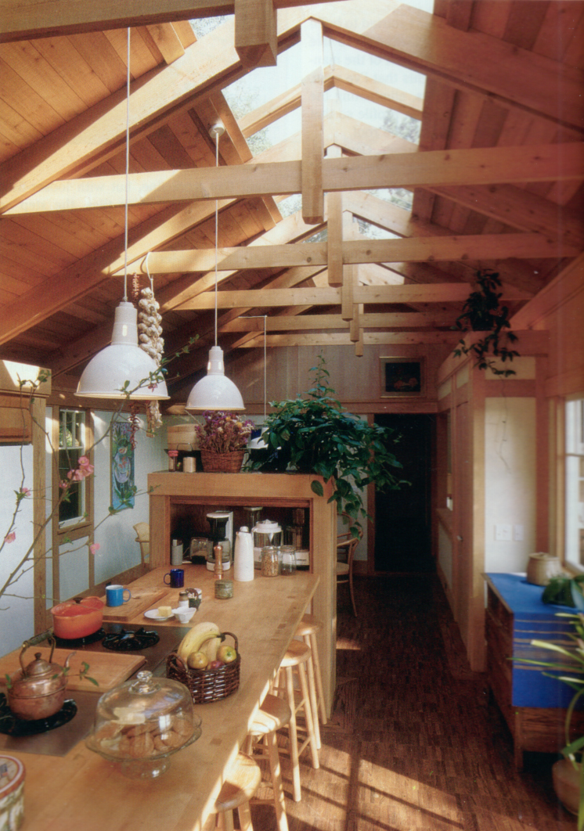
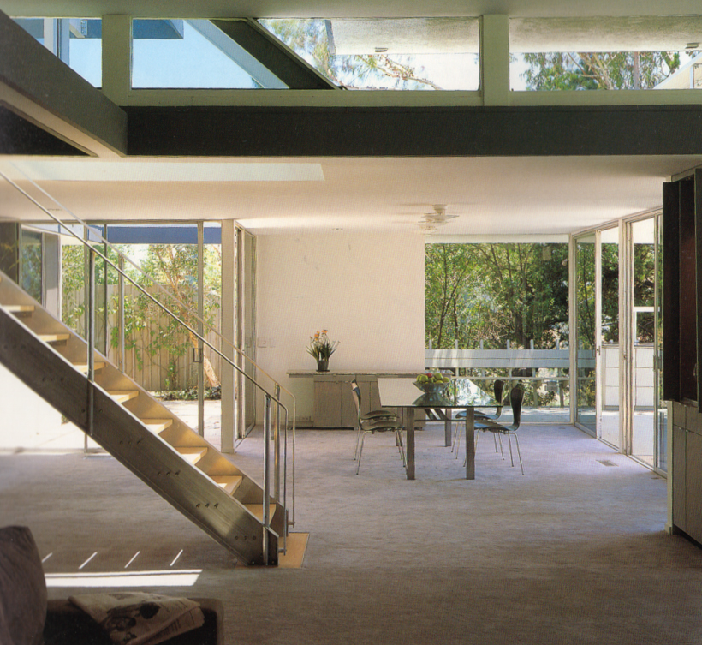
When light for a second side is not possible allow light from above.

Slide 27
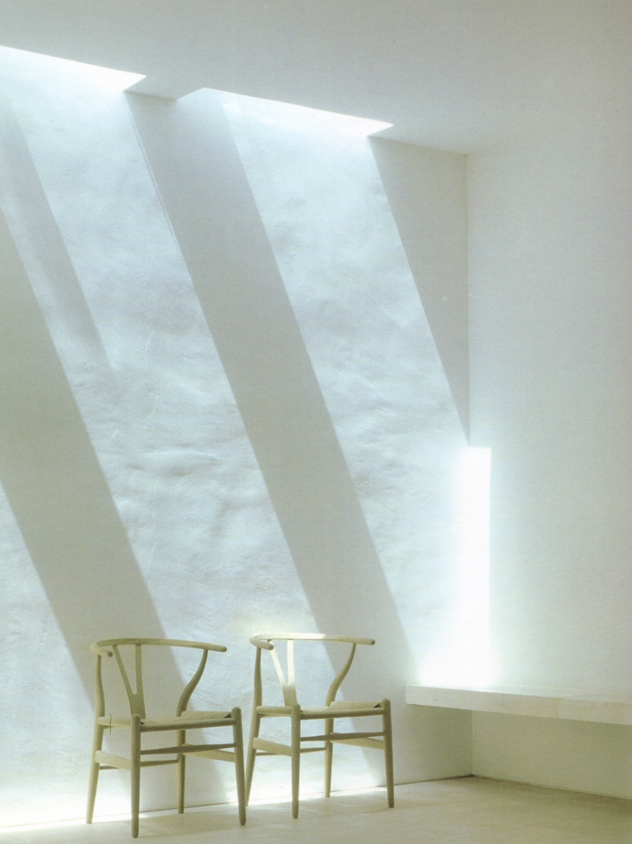
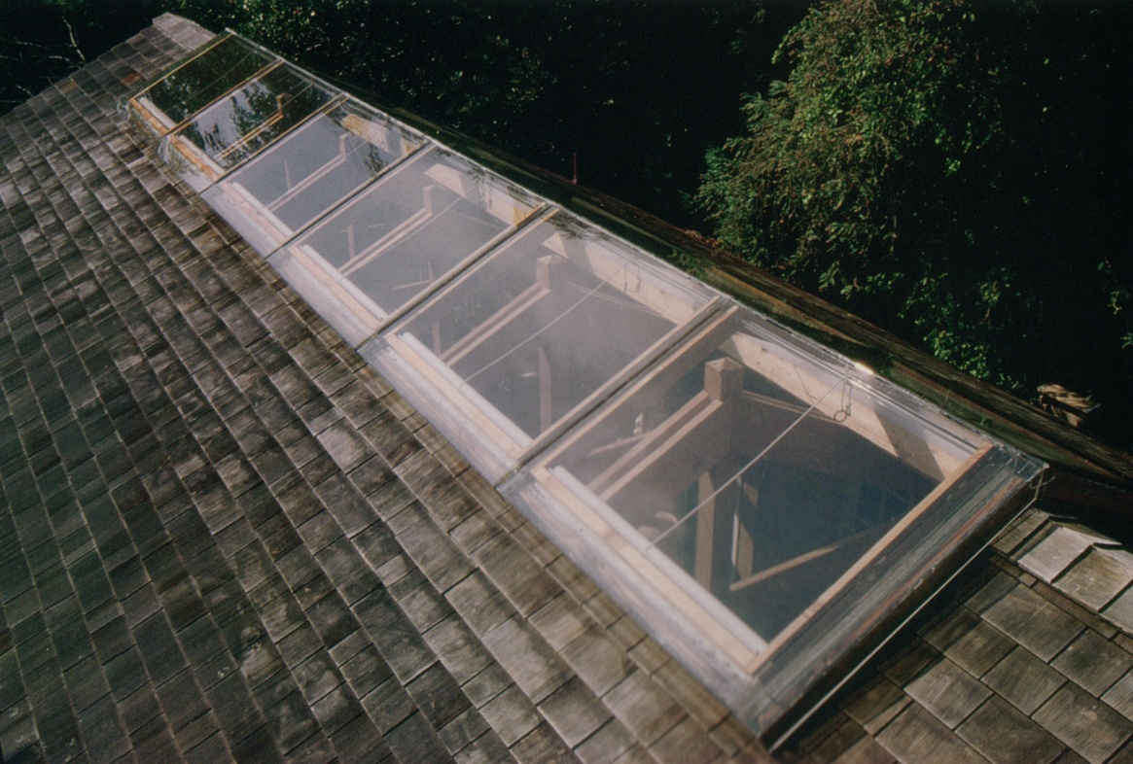
When light for a second side is not possible allow light from above.

Slide 28
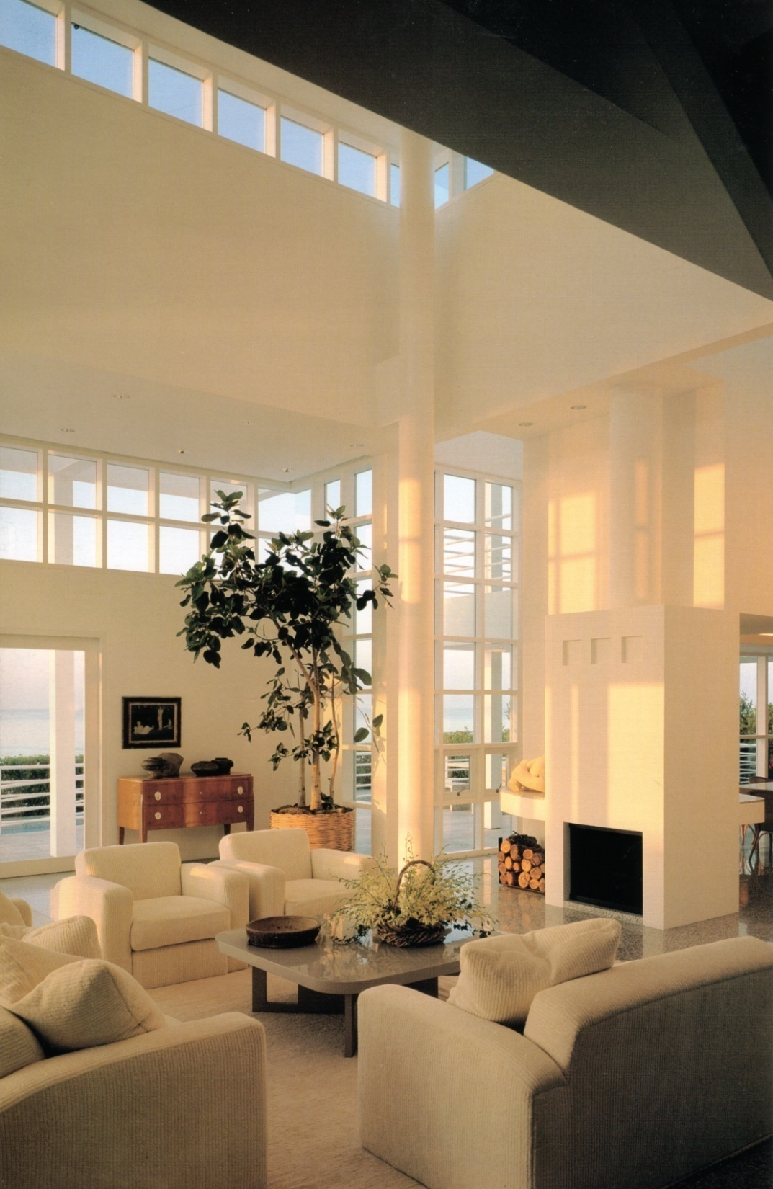
Plan the placement of rooms so light is received at suitable times of the day.
Capturing Morning Light
The light has a more orange/yellow hue earlier in the day.

Slide 29
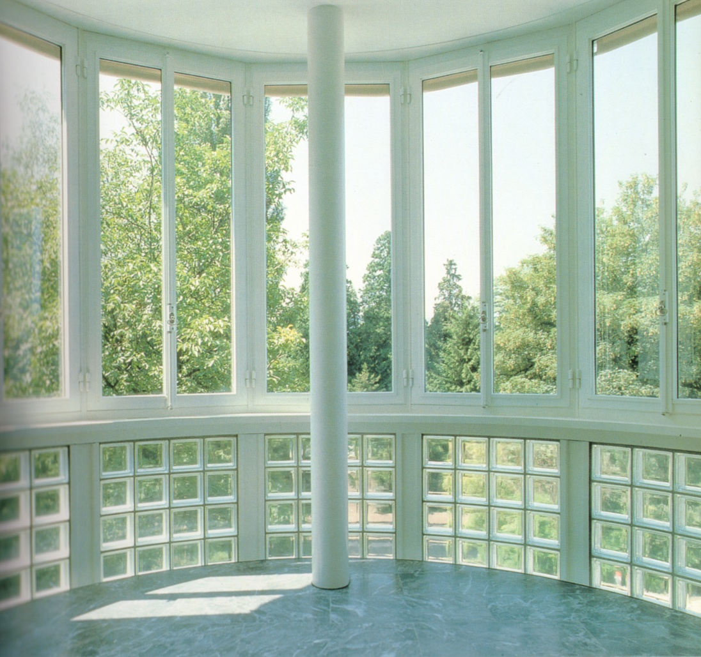
Plan the placement of rooms so light is received at desired times of the day.
Capturing light all day with a southern exposure.
The color of the light will shift during the day as a natural result of the movement of the sun and changing light angles.

Slide 30
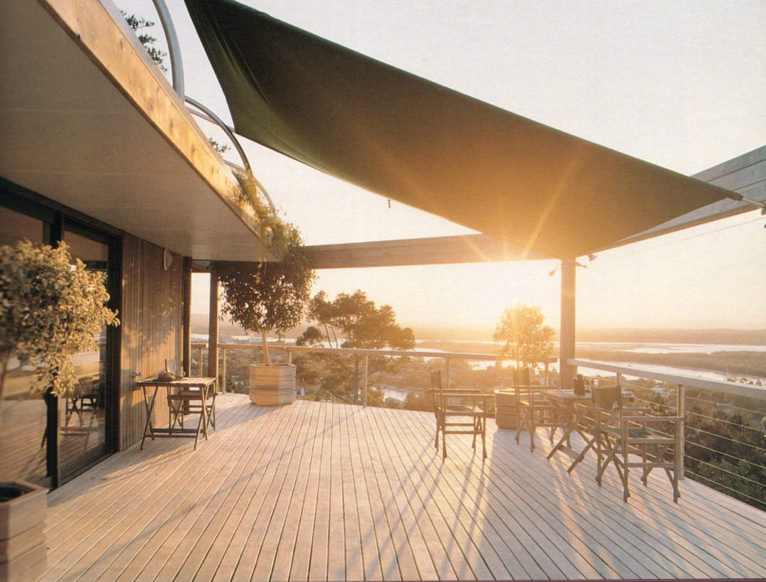
Plan the placement of rooms so light is received at desired times of the day.
Capturing Evening Light
The light has a more orange/yellow hue later in the day.

Slide 31
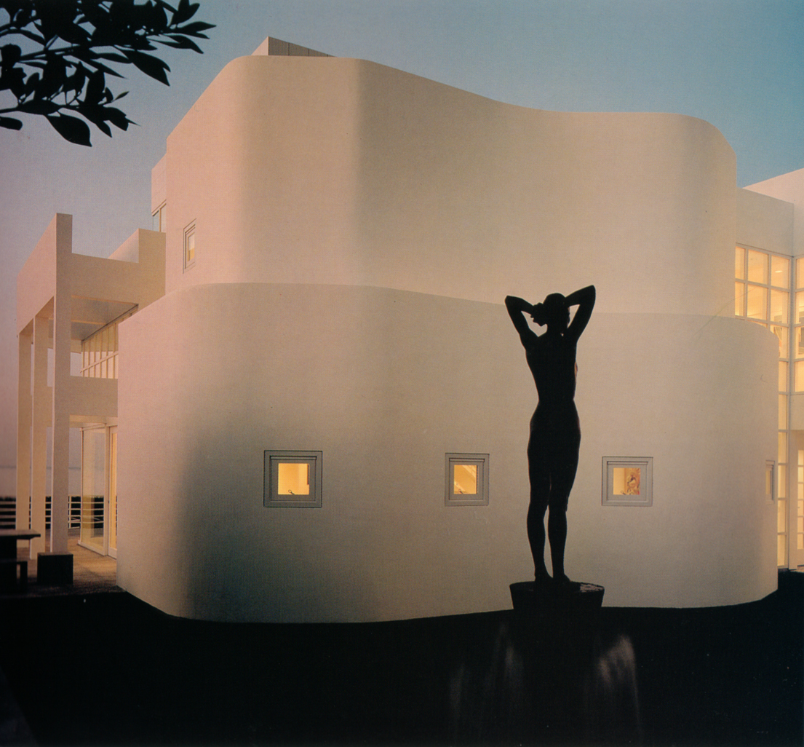
Plan the placement of rooms so light is received at desired times of the day.
Capturing Evening Light.
Accentuates the forms, provides color on white surfaces.

Slide 32
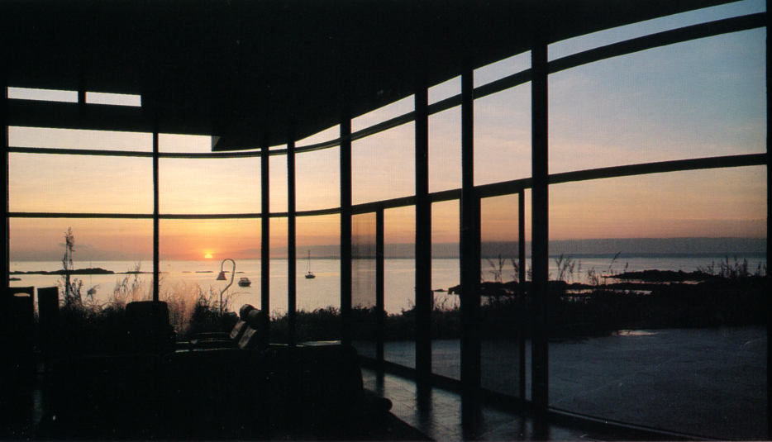
Plan the placement of rooms so light is received at desired times of the day.
Capturing Evening Light
The light has a more orange/yellow hue later in the day.

Slide 33
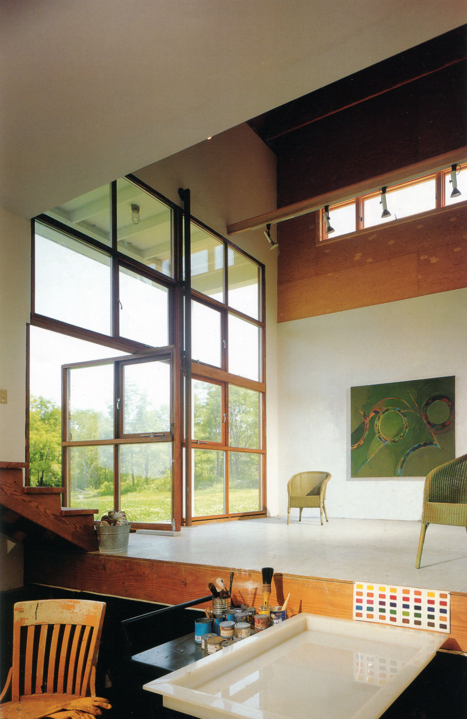
Create the size and shape of the opening (windows) to suite the activities and the climate.
North Facing Studio
Strong link with light and nature.
Light enters the room from two directions.

Slide 34
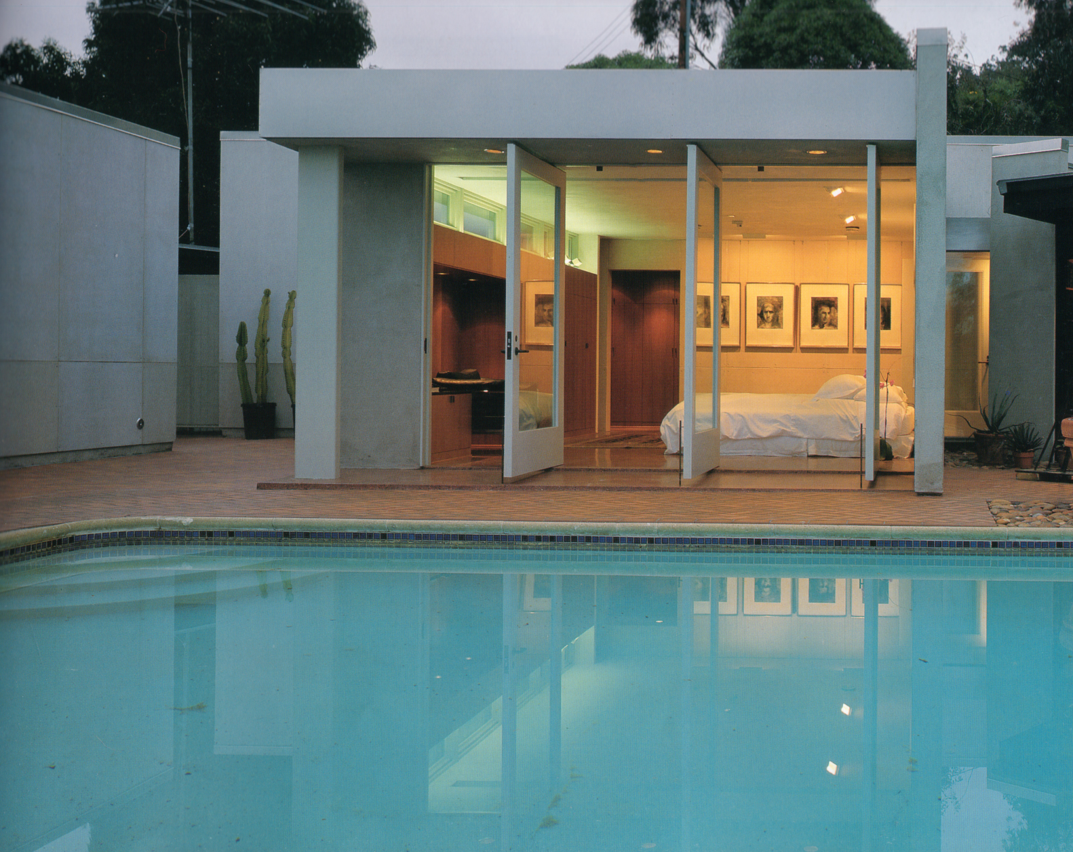
Create the size and shape of the opening (windows) to suite the activities and the climate.
Laguna Beach, CA
Notice that the light can enter the room from two directions.

Slide 35
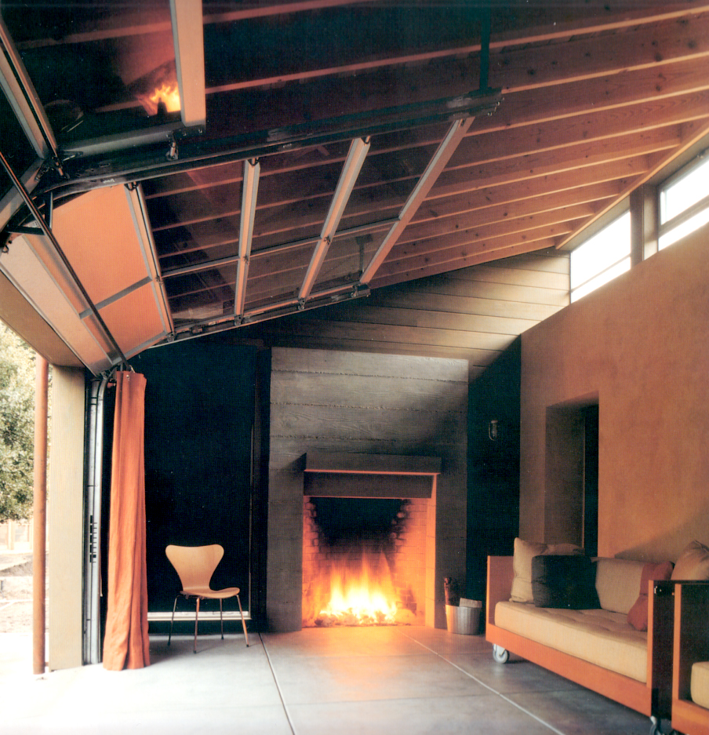
Create the size and shape of the opening (windows) to suite the activities and the climate.
Marin County, CA
Notice that the light can enter the room from two directions.

Slide 36
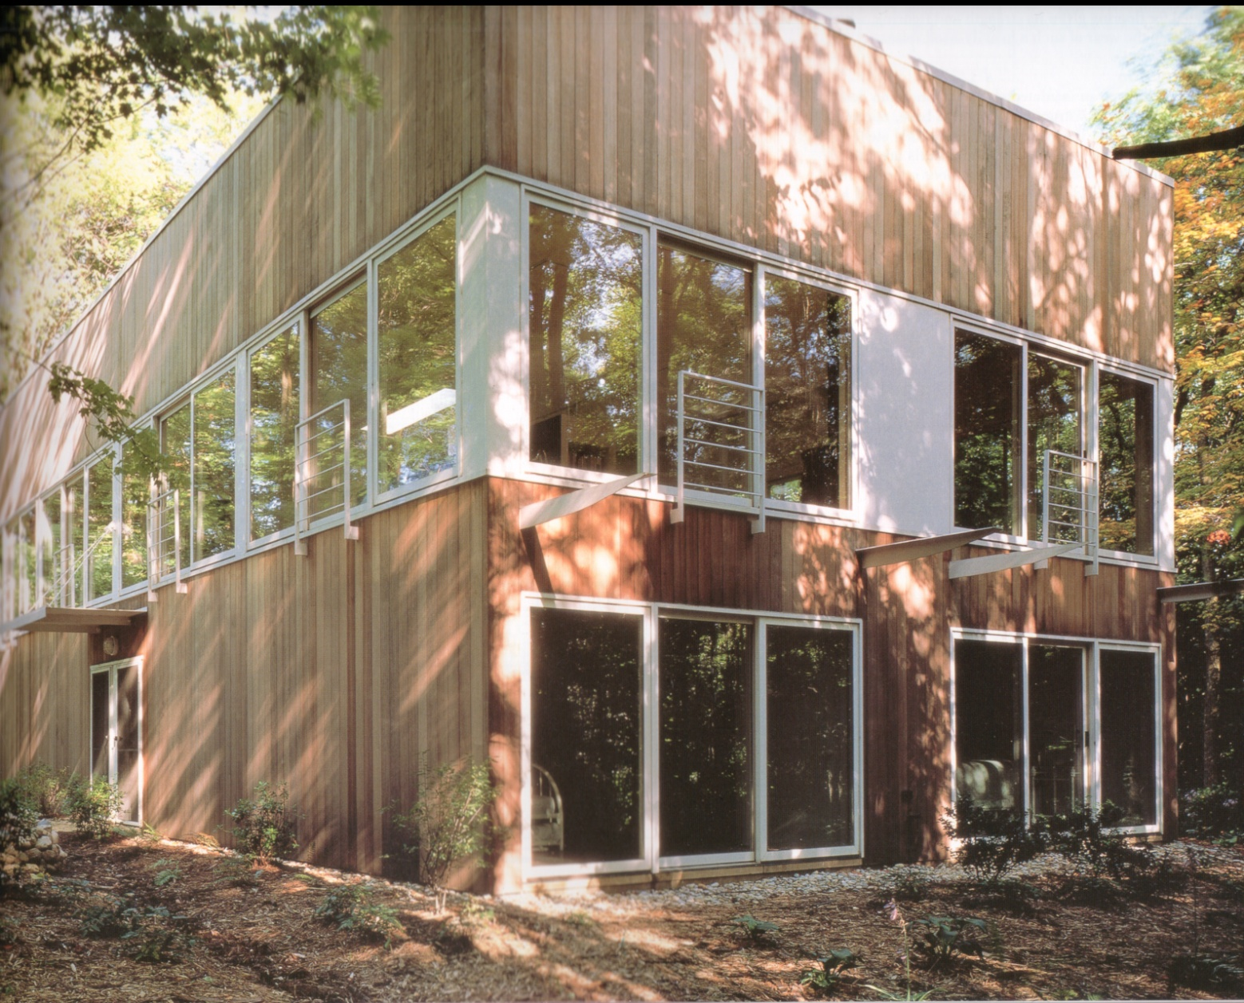
Create the size and shape of the opening (windows) to suite the activities and the climate.
The building takes advantage of the foliage of the trees.

Slide 37
An Architect Designed Low Energy Use House: Sort Of
Watch with a critical eye towards total energy use

Slide 38
Steven Holl, American architect known for his designing with light and color.
http://www.youtube.com/watch?v=Z1EdclmS7wE&feature=related
Video of the ‘Sun Slice House’ by Steven Holl
http://www.youtube.com/watch?v=MDJIiUHObgw&feature=related
Video of the ‘Knut Hamsun Center’ by Steven Holl

Slide 39
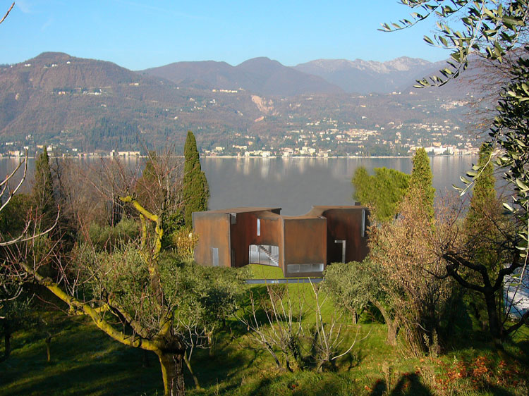
SUN SLICE HOUSE
Lake Garda, Italy, 2006, Steven Holl, Architects

Slide 40
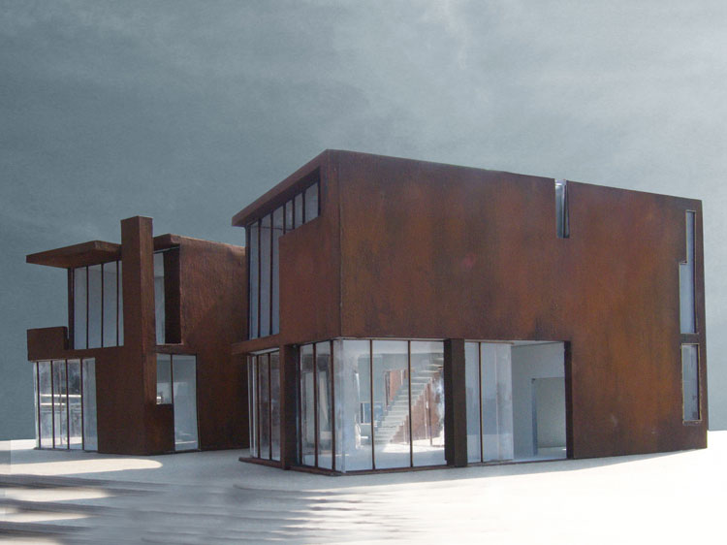

Slide 41
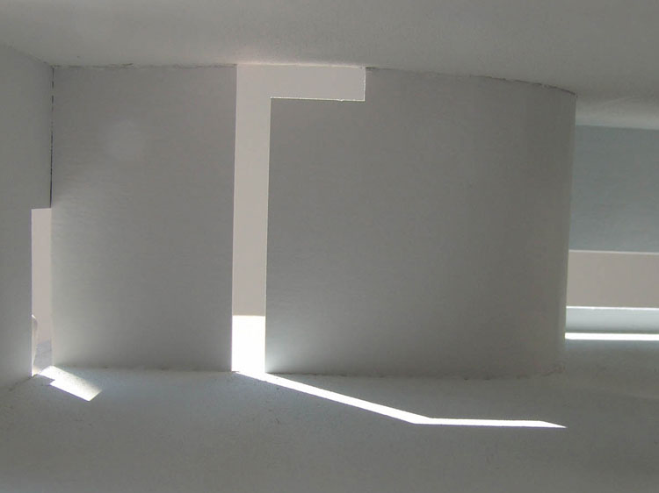

Slide 42
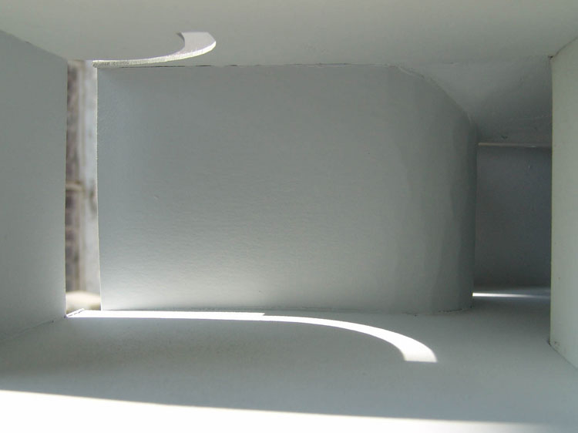

Slide 43
Slices of natural light and their change in space throughout the day and year is the focus of the house.
The steel frame and concrete structure is skinned with an alloy of copper, steel, chromium, and nickel, which weathers to a leathery red color.
Interiors are white plaster with terrazzo floors on the ground level.

Slide 44
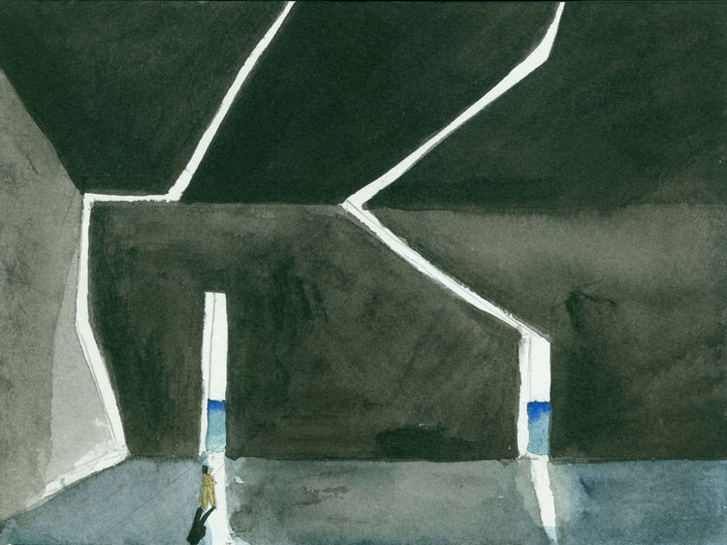
Steven Holl watercolors: these are studies for the design of possible interior and exterior architectural conditions

Slide 45
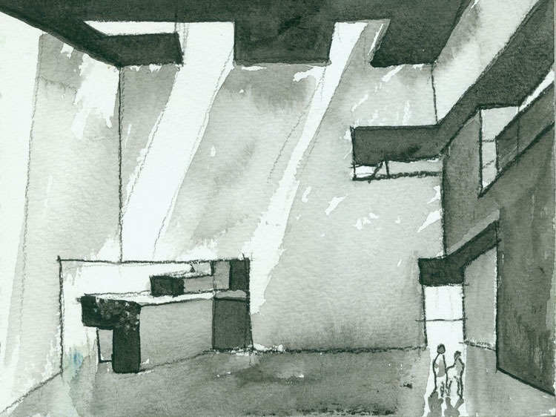

Slide 46
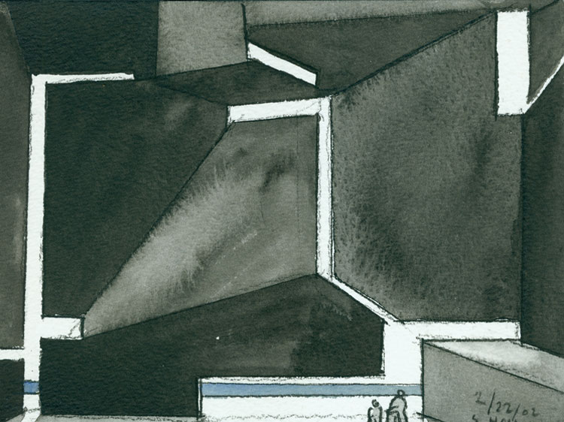

Slide 47
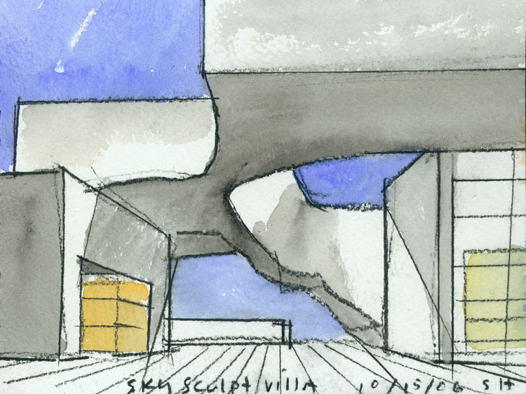

Slide 48


Slide 49

DAEYANG GALLERY AND HOUSE
Seoul, Korea, 2008-June 2012, Steven Holl, Architects

Slide 50


Slide 51


Slide 52


Slide 53

PLANAR HOUSE
AZ, United States, 2002-2005, Steven Holl, Architects

Slide 54


Slide 55


Slide 56



Slide 57


Slide 58

This house is designed using light as a creative, enriching experience

